Slide 1
Advance Database Management System UML Diagrams Tutorial

Slide 2
Learning Objectives
To know about:
Class Diagram
Use Case Diagram
Activity Diagram

Slide 3
Class Diagram

Slide 4
What is Class Diagram?
The Class diagram represents classes, their component parts, and the way in which classes of objects are related to one another.
The Class diagram includes attributes, operations, stereotypes, properties, associations, and inheritance.

Slide 5
Components of Class Diagram
Attributes describe the appearance and knowledge of a class of objects.
Operations define the behavior that a class of objects can manifest.
Stereotypes help you understand this type of object in the context of other classes of objects with similar roles within the system’s design.
Properties provide a way to track the maintenance and status of the class definition.
Association is just a formal term for a type of relationship that this type of object may participate in. Associations may come in many variations, including simple, aggregate and composite, qualified, and reflexive.
Inheritance allows you to organize the class definitions to simplify and facilitate their implementation.

Slide 6
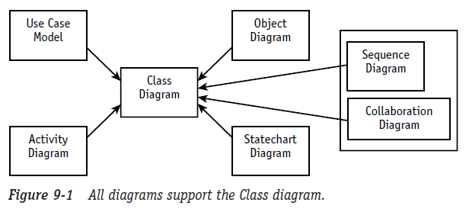
Why Class Diagram is necessary?
Although other diagrams are necessary, remember that their primary purpose is to support the construction and testing of the Class diagram.
Whenever another diagram reveals new or modified information about a class, the Class diagram must be updated to include the new information. If this new information is not passed on to the Class diagram, it will not be reflected in your code.

Slide 7
The Class Symbol
The class symbol is comprised of three compartments (rectangular spaces) that contain distinct information needed to describe the properties of a single type of object.
The name compartment uniquely defines a class (a type of object) within a package. Consequently, classes may have the same name if they reside in different packages.
The attribute compartment contains all the data definitions.
The operations compartment contains a definition for each behavior supported by this type of object.

Slide 8
Attribute
An attribute describes a piece of information that an object owns or knows about itself.
Attribute visibility:
Public (+) visibility allows access to objects of all other classes.
Private (-) visibility limits access to within the class itself. For example, only operations of the class have access to a private attribute.
Protected (#) visibility allows access by subclasses. In the case of generalizations (inheritance), subclasses must have access to the attributes and operations of the superclass or they cannot be inherited.
Package (~) visibility allows access to other objects in the same package.

Slide 9
Attribute
visibility / attribute name : data type = default value {constraints}
Visibility (+, -, #, ~): Required before code generation. The programming language will typically specify the valid options. The minus sign represents the visibility “private” meaning only members of the class that defines the attribute may see the attribute.
Slash (/): The derived attribute indicator is optional. Derived values may be computed or figured out using other data and a set of rules or formulas. Consequently, there are more design decisions that need to be addressed regarding the handling of this data. Often this flag is used as a placeholder until the design decisions resolve the handling of the data.
Attribute name: Required. Must be unique within the class.
Data type: Required. This is a big subject. During analysis, the data type should reflect how the client sees the data. You could think of this as the external view. During design, the data type will need to represent the programming language data type for the environment in which the class will be coded. These two pieces of information can give the programmer some very specific insights for the coding of get and set methods to support access to the attribute value.
Assignment operator and default value: Optional. Default values serve two valuable purposes. First, default values can provide significant ease-of-use improvements for the client. Second and more importantly, they protect the integrity of the system from being corrupted by missing or invalid values. A common example is the tendency to let numeric attributes default to zero. If the application ever attempts to divide using this value, you will have to handle resulting errors that could have been avoided easily with the use of a default.
Constraints: Constraints express all the rules required to guarantee the integrity of this piece of information. Any time another object tries to alter the attribute value, it must pass the rules established in the constraints. The constraints are typically implemented/enforced in any method that attempts to set the attribute value.
Class level attribute (underlined attribute declaration): Optional. Denotes that all objects of the class share a single value for the attribute. (This is called a static value in Java.)

Slide 10
Operation
Objects have behaviors, things they can do and things that can be done to them. These behaviors are modeled as operations.
Operations require a name, arguments, and sometimes a return.
Arguments, or input parameters, are simply attributes, so they are specified using the attribute notation (name, data type, constraints, and default), although it is very common to use the abbreviated form of name and data type only.

Slide 11
Operation
visibility operationName ( argname : data type {constraints}, ...) :return data type {constraints}
Visibility (+, -, #, ~): Required before code generation. The visibility values are defined by the programming language, but typically include public (+), private (-), protected (#), and package (~).
Operation name: Required. Does not have to be unique, but the combination of name and parameters does need to be unique within a class.
Arguments/parameters: Any number of arguments is allowed. Each argument requires an identifier and a data type. Constraints may be used to define the valid set of values that may be passed in the argument. But constraints are not supported in many tools and will not be reflected in the code for the operation, at least not at this point.
Argument name: Required for each parameter, but parameters are optional. Any number of arguments is allowed.
Argument data type: Required for each parameter, but parameters are optional.
Constraints: Optional. In general, constraints express rules that must be enforced in the execution of the operation. In the case of parameters, they express criteria that the values must satisfy before they may be used by the operation. You can think of them as operation level pre-conditions.
Return data type: Required for a return value, but return values are optional. The UML only allows for the type, not the name, which is consistent with most programming languages. There may only be one return data type, which again is consistent with most programming languages.
Class level operation (underlined operation declaration): Optional. Denoted as an operation accessible at the class level; requires an instance (object) reference.

Slide 12
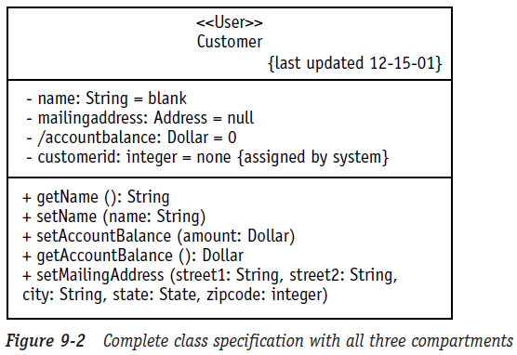
Class Notation
Name Compartment
Attribute Compartment
Operation Compartment

Slide 13
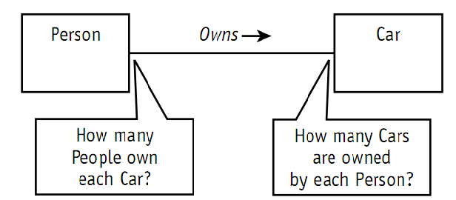
Association multiplicity
The UML allows you to handle some other important questions about associations: “How many Cars may a Person own?” “How many can they rent?” “How many people can drive a given Car?”
Associations define the rules for how objects in each class may be related. So how do you specify exactly how many objects may participate in the relationship?

Slide 14
Association multiplicity
Summary list of the options for specifying multiplicity followed by some examples.
Values separated by two periods (..) mean a range. For example, 1..3 means between 1 and 3 inclusively; 5..10 means between 5 and 10 inclusively.
Values separated by commas mean an enumerated list of possibilities. For example, 4,6,8 means you may have 4 objects or 6 objects or 8 objects of this type in the association.
Asterisk (*) when used alone means zero or more, no lower or upper limit.
Asterisk (*) when used in a range (1..*) means no upper limit—you must have at least one but you can have as many more as you want.

Slide 15
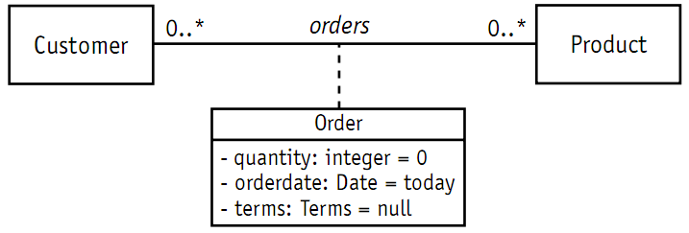
Association Class
Encapsulates information about an association.

Slide 16
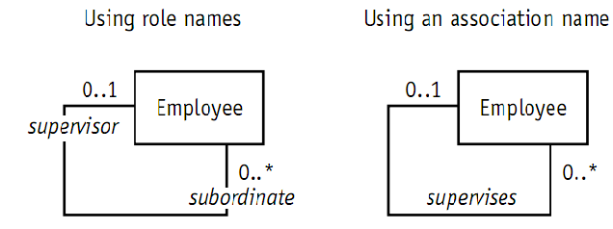
Reflexive Association
Reflexive association is a fancy expression that says objects in the same class can be related to one another. The entire association notation you’ve learned so far remains exactly the same, except that both ends of the association line point to the same class.

Slide 17
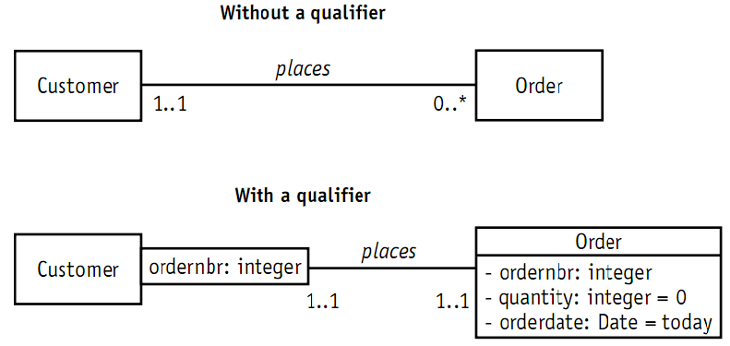
Qualified Association

Slide 18
Aggregation and Composition
Aggregation is a special type of association used to indicate that the participating objects are not just independent objects that know about each other. Instead, they are assembled or configured together to create a new, more complex object.
For example, a number of different parts are assembled to create a car, a boat, or a plane.
Composition is used for aggregations where the life span of the part depends on the life span of the aggregate.
The aggregate has control over the creation and destruction of the part. In other words, the member object cannot exist apart from the aggregation.

Slide 19
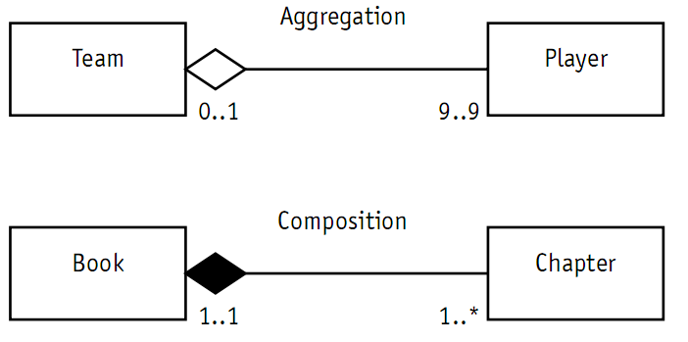
Aggregation and Composition
Players are assembled into a team. But if the Team is disbanded, the players live on (depending of course on how well they performed).
The Book example uses composition, the solid diamond. A Book is composed of Chapters. The Chapters would not continue to exist elsewhere on their own. They would cease to exist along with the Book.

Slide 20
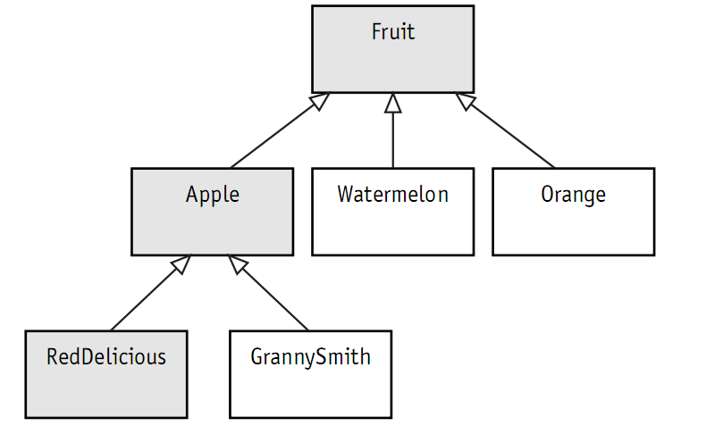
Generalization
Generalization is the process of organizing the properties of a set of objects that share the same purpose.
A generalization is not an association.

Slide 21
Case Study: Class Diagram
Student may attend any number of courses
Every course may have any number of students
Instructors teach courses
For every course there is at least one instructor
Every instructor may teach zero or more courses
A school has zero or more students
Each student may be a registered member of one or more school
A school has one or more departments
Each department belongs to exactly one school
Every instructor is assigned to one or more departments
Each department has one or more instructors
For every department there is exactly one instructor acting as the department chair

Slide 22
Use Case Diagram

Slide 23
What is Use Case?
A use case is a description of a set of sequences of actions, including variants, that a subject performs to yield an observable result of value to an actor.
For example, one central use case of a bank is to process loans for its loan applicants/ clients/ customers.

Slide 24
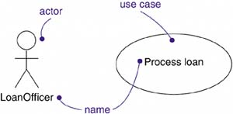
What is Actor?
An actor represents a coherent set of roles that users of use cases play when interacting with these use cases.
Actors can be human or they can be automated systems.
For example, in modeling a bank, processing a loan involves, among other things, the interaction between a customer and a loan officer.

Slide 25
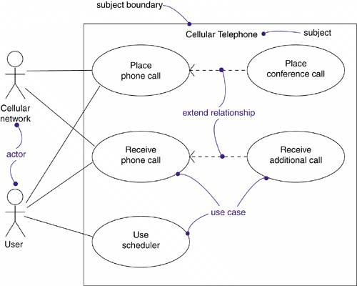
Use Case Diagram
Apply use case diagrams to visualize the behavior of a system, so that users can comprehend how to use that element, and so that developers can implement that element

Slide 26
Modeling the Requirements of a System
Establish the context of the system by identifying the actors that surround it
For each actor, consider the behavior that each expects or requires the system to provide
Name these common behaviors as use cases
Model these use cases, actors, and their relationships in a use case diagram
Enhance these use cases with notes or constraints

Slide 27
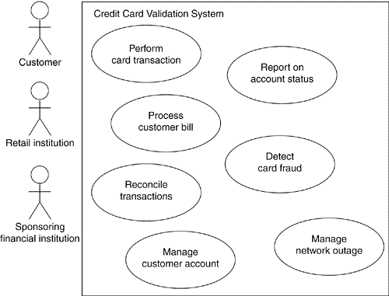
Modeling the Requirements of a System

Slide 28
Elements of Use Case Diagram

Slide 29
Relationships in Use Case Diagram
Association
Between Actor and Use Case
NOT between Use Cases
Generalization
Between Actors
Between Use Cases
Dependency
Between Use Cases
<<include>> and <<extend>>

Slide 30
Actors
Find the people, systems, or devices that communicate with the system
The system-type actors are often easiest to spot

Slide 31
Notation of Actors

Slide 32
Dependency
<<include>>
Mandatory dependency
<< i >>
Arrow towards the use case dependent on
<<extend>>
Optional Dependency
<< e >>
Arrow from the use case dependent on
Often referred as options of the use case

Slide 33
<<include>> & <<extend>>

Slide 34
Generalization
The child use case inherits the
behavior and meaning of the parent use case.
The child may add to or
override the behavior of its parent.

Slide 35
Case Study: Use Case Diagram
In a hotel management system a guest can rent rooms. Hotel receptionist uses the system to assist in the renting. A guest can also book a room for future renting with the help of the receptionist, but he has to check if the room has prior booking or not. A Guest pays for the rooms at the time they check out. He can pay by cash, check or credit card. Receptionists has to logon to the system before they can use it, but to logon he has go through username/password verification.

Slide 36
Activity Diagram

Slide 37
Learning Objectives
To know about:
Activity Diagram
Components of Activity Diagram

Slide 38
Activity Diagram
The Activity diagram is the UML version of the classic flowchart. It may be applied to any process, large or small.
An Activity diagram is a series of activities linked by transitions, arrows connecting each activity. Typically, the transition takes place because the activity is completed. For example, you’re currently in the activity “reading a page.” When you finish this activity, you switch to the activity “turning page.”

Slide 39
Guard Condition
Sometimes the transition should only be used when certain things have happened. A guard condition can be assigned to a transition to restrict use of the transition. Place the condition within square brackets somewhere near the transition arrow. The condition must test true before you may follow the associated transition to the next activity.

Slide 40
Decision
The Activity diagram diamond is a decision icon, just as it is in flowcharts. In either diagram, one arrow exits the diamond for each possible value of the tested condition. The decision may be as simple as a true/false test The decision may involve a choice between a set of options.

Slide 41
Merge Point
The diamond icon is also used to model a merge point, the place where two alternative paths come together and continue as one. The two paths in this case are mutually exclusive routes. For example, you and I might each walk from your house to the store. I choose to walk down the left side of the street while you walk down the right. But two blocks before the store we both have to turn right and walk on the right side of that street to the store’s front door.

Slide 42
Start and End
The UML also provides icons to begin and end an Activity diagram. A solid dot indicates the beginning of the flow of activity. A bull’s-eye indicates the end point. There may be more than one end point in an Activity diagram. Even the simplest Activity diagram typically has some decision logic that would result in alternative paths, each with its own unique outcome. If you really want to, you can draw all your arrows to the sameend point, but there is no need to do so. Every end point means the same thing: Stop here.

Slide 43
Concurrency
The UML notation for the Activity diagram also supports concurrency. To show that a single process starts multiple concurrent threads or processes, the UML uses a simple bar called a fork.

Slide 44
Concurrency
The Synchronization or merging of the concurrent threads or processes is shown in much the same way.

Slide 45
Case Study: Activity Diagram
In a computer shop, customers choose a laptop from the display shelf. The sales person then explains the features to the customer. If the customer does not like it, he leaves the shop and visits the next one. Otherwise the customer enquiries if there are any other color available. The sales person searches the system for available colors. Then the customer chooses the color and confirms the specific laptop that he wants to buy. The laptop is then sent to the service department for software installation and at the same time the bill is generated. While software are being installed, the customer collects a wireless mouse and a bag which comes free with the laptop. When software installation is finished, the customer collects the laptop from service department. Then he pays the bill in the bill paying counter.

Slide 46
THANK YOU

